Slide 1
VISUALIZING EMPLOYEE ATTENDANCE TRENDS WITH EXCEL CHART
STUDENT NAME: SRIKA P
REGISTER NO: 312217065 (asunm1659312217065)
DEPARTMENT: BCOM (GENERAL)
COLLEGE: SHRI KRISHNASWAMY COLLEGE FOR WOMEN

Slide 2

PROJECT TITLE
Visualizing Employee Attendance Trends With Excel Chart

Slide 3

AGENDA
Problem Statement
Project Overview
End Users
Our Solution and Proposition
Dataset Description
Modelling Approach
Results and Discussion
Conclusion
3/21/2024 Annual Review

Slide 4
PROBLEM STATEMENT
"Design a data visualization solution in Excel to track and analyze employee attendance patterns, enabling HR managers to:
- Monitor attendance trends and anomalies
- Identify frequent absentees and tardy employees
- Analyze attendance by department, team, and location
_Key Challenges:_
- Handling large datasets with varying attendance codes
- Creating intuitive and interactive visualizations
_Deliverables:_
- Excel dashboard for employee attendance visualization
- Interactive charts and tables for attendance analysis

Slide 5
PROJECT OVERVIEW
This project aims to transform raw employee attendance data into actionable insights. By leveraging advanced visualization techniques, we will create interactive dashboards that provide a clear and comprehensive picture of attendance patterns, trends, and anomalies. These visualizations will empower HR teams to identify areas for improvement, optimize scheduling, and make data-driven decisions to enhance overall workforce productivity and employee satisfaction.

Slide 6


WHO ARE THE END USERS?
HR Manager
Department Heads
Payroll Specialist
Team Leads
Operation Managers
Business Analysts
Executive Leadership

Slide 7

OUR SOLUTION AND ITS VALUE PROPOSITION
Conditional Formatting - Missing
Filter - Remove
Formula - Performance
Pivot - Summary
Graph - Data visualization

Slide 8

Dataset Description
Employee - Kaggle
26 Features
9 Features
Employee ID Number
Name - Text
Employee Type
Performance Level
Gender - Male/Female
Employee Rating

Slide 9
THE "WOW" IN OUR SOLUTION
Data Collection :
Employee Information
Attendance Record
Leave & Absence Record
Feature Collection :
Data Points
Granularity & User roles
Data Cleaning :
Handling Missing Values
Identifying & Removing Outliers
Summary :
Overall Attendance
Overtime Hours
3/21/2024 Annual Review

Slide 10
MODELLING
To visualize employee attendance effectively, you need to structure your data with fields like Employee ID, Date, and Attendance Status. Then, use visualizations like line charts, bar charts, heatmaps, and pie charts to track trends, compare attendance across different periods or departments, and identify patterns. Remember to consider factors like granularity, filters, metrics, data quality, and security when designing your visualizations.

Slide 11
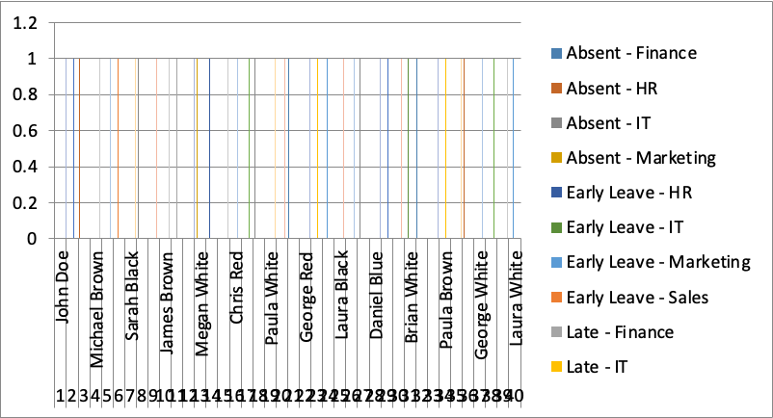
RESULTS

Slide 12

CONCLUSION
Visualizing employee attendance data provides valuable insights into workforce patterns, productivity, and potential issues. By effectively representing this information, organizations can make informed decisions, improve employee engagement, and enhance overall performance.

